Slide 1
Population
Data Collection
Sample
Inference

Slide 2
Unbiased
Biased
Low Variability
High Variability

Slide 3




Observational Study
Controlled Experiment
Gentle Bedside Manner
Kangaroo Care
Poor Bedside Manner
No Kangaroo Care

Slide 4
Confounder
(Temperature)
(Higher Temps → More Ice Cream)
(Higher Temps → Higher Risk)
Factor of Interest
(Ice Cream Sales)
Effect ?
Response of Interest
(Risk of Shark Attack)

Slide 5


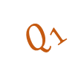




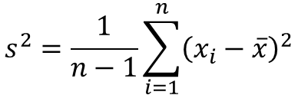

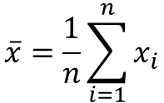

median
$$Q_{1}$$
$$Q_{3}$$
$$x_{i}=\text{i}\text{−}\text{th} \text{value}$$
$$\overline{x}=\frac{1}{n}\sum_{i=1}^{n}{x_{i}}$$
$$s^{2}=\frac{1}{n−1}\sum_{i=1}^{n}{{\left(x_{i}−\overline{x}\right)}^{2}}$$
$$Q_{1}=\text{25−}\text{th} \text{percentile}$$
median$=\text{50−}\text{th} \text{percentile}$
$$Q_{3}=\text{75−}\text{th} \text{percentile}$$
$$(x_{i}−\overline{x})$$
$$IQR=Q_{3}−Q_{1}$$
$$\overline{x}$$

Slide 6

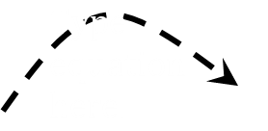





Population
$$\hat{θ}=\text{Estimate} \text{of} \text{Parameter}$$
$$\text{Sample}\text{ 1}→{\hat{θ}}_{1}$$
$$\text{Sample}\text{ 2}→{\hat{θ}}_{2}$$
$$\text{Parameter}=θ$$
Sampling Distribution
$$⋮$$
Random Sampling
$$\text{Sample} \text{m}→{\hat{θ}}_{m}$$

Slide 7






Population
Resampling
Bootstrap Resamples
$$\text{Resample}\text{ 1}→{\hat{θ}}_{1}^{∗}$$
$$\text{Original} \text{Statistic}=\hat{θ}$$
$$\text{Resample}\text{ 2}→{\hat{θ}}_{2}^{∗}$$
$$\text{Parameter}=θ$$
Bootstrap Model for Sampling Distribution
$$⋮$$
$$\text{Resample} \text{m}→{\hat{θ}}_{m}^{∗}$$

Slide 8





Null World
$$\text{Null} \text{Sample}\text{ 1}→{\hat{θ}}_{1}^{∗}$$
$$\text{Null} \text{Sample}\text{ 2}→{\hat{θ}}_{2}^{∗}$$
Null Distribution
$$⋮$$
$$θ=0.2$$
$$\text{Null} \text{Sample}\text{ 3}→{\hat{θ}}_{m}^{∗}$$

Slide 9
Group Mean
Within Group Variability
Between Group Variability
Response
Group I
Group II
Group III

Slide 10
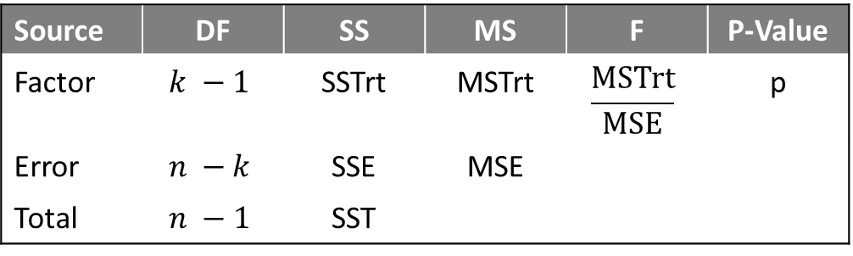
Partitioning Variability
Source | DF | SS | MS | F | P-Value
Factor | $$k −1$$ | SSTrt | MSTrt | $$\frac{\text{MSTrt}}{\text{MSE}}$$ | p
Error | $$n −k$$ | SSE | MSE
Total | $$n −1$$ | SST
Standardized Test Statistic
Estimate of Residual Variability

Slide 11
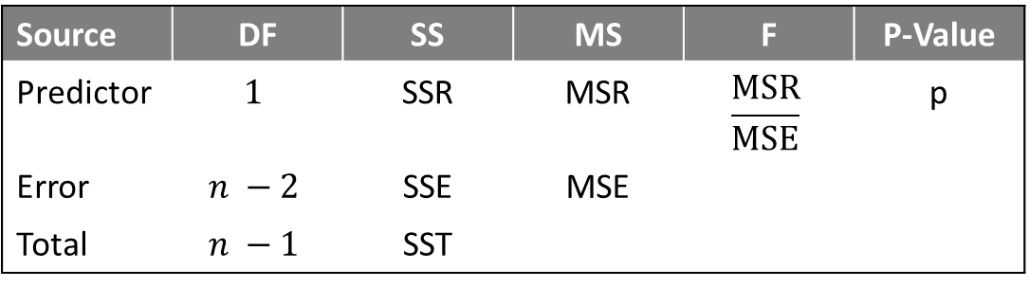
Partitioning Variability
Source | DF | SS | MS | F | P-Value
Predictor | $$1$$ | SSR | MSR | $$\frac{\text{MSR}}{\text{MSE}}$$ | p
Error | $$n −2$$ | SSE | MSE
Total | $$n −1$$ | SST
Standardized Statistic
Estimate of Residual Variability

Slide 12
Response
Predictor

Slide 13
$${\left(\text{Response}\right)}_{i}−\left(\text{Average} \text{Response}\right)→SST$$
Average Response
Response
$${\left(\text{Predicted} \text{Response}\right)}_{i}−\left(\text{Average} \text{Response}\right)→SSR$$
$${\left(\text{Response}\right)}_{i}−{\left(\text{Predicted} \text{Response}\right)}_{i}→SSE$$
Predictor

Slide 14
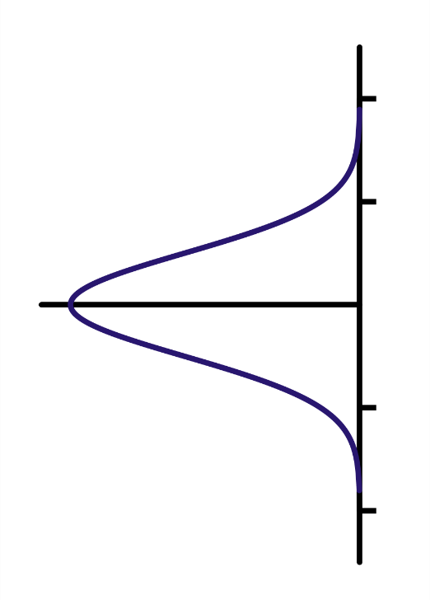

$$\text{Response}=β_{0}+β_{1}\text{Predictor}$$
All Independent
Variability in Errors
Response
Variability in Errors
Variability in Errors
Predictor

Slide 15
All Independent
Variability in Errors
Response
Variability in Errors
Variability in Errors
Factor

Slide 16
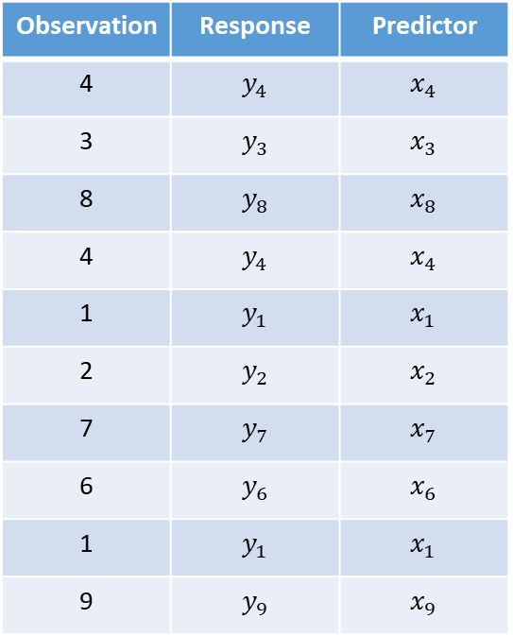
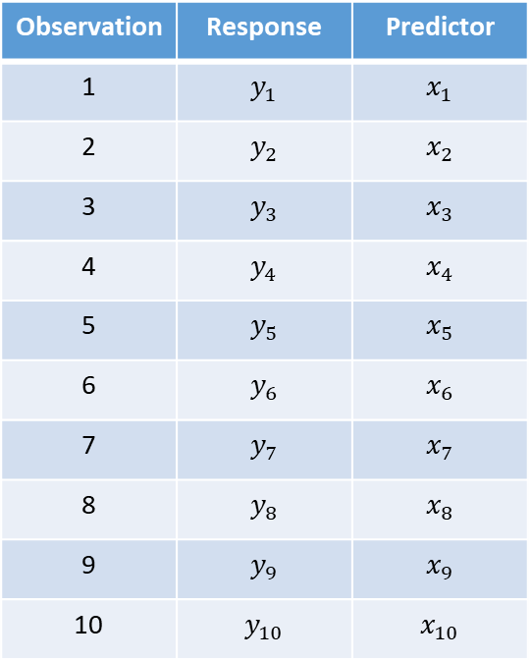
Original Sample
Example Bootstrap Resample
Observation | Response | Predictor
1 | $$y_{1}$$ | $$x_{1}$$
2 | $$y_{2}$$ | $$x_{2}$$
3 | $$y_{3}$$ | $$x_{3}$$
4 | $$y_{4}$$ | $$x_{4}$$
5 | $$y_{5}$$ | $$x_{5}$$
6 | $$y_{6}$$ | $$x_{6}$$
7 | $$y_{7}$$ | $$x_{7}$$
8 | $$y_{8}$$ | $$x_{8}$$
9 | $$y_{9}$$ | $$x_{9}$$
10 | $$y_{10}$$ | $$x_{10}$$
Observation | Response | Predictor
4 | $$y_{4}$$ | $$x_{4}$$
3 | $$y_{3}$$ | $$x_{3}$$
8 | $$y_{8}$$ | $$x_{8}$$
4 | $$y_{4}$$ | $$x_{4}$$
1 | $$y_{1}$$ | $$x_{1}$$
2 | $$y_{2}$$ | $$x_{2}$$
7 | $$y_{7}$$ | $$x_{7}$$
6 | $$y_{6}$$ | $$x_{6}$$
1 | $$y_{1}$$ | $$x_{1}$$
9 | $$y_{9}$$ | $$x_{9}$$
Randomly Resample

Slide 17
Response
Block A
Block B
Block C
Block D
Group I
Group II
Group III

Slide 18

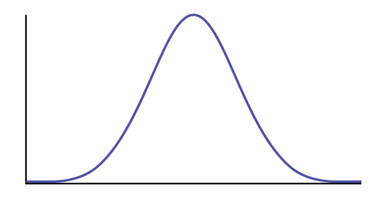

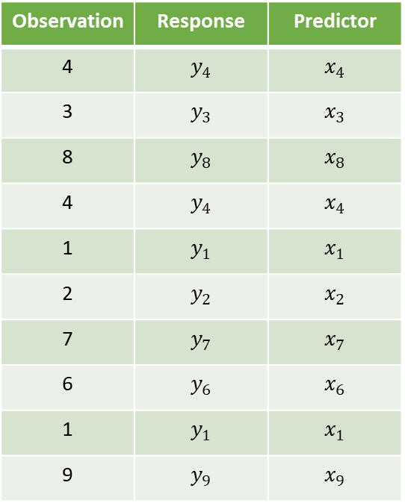



Data Generating Process
Data
Statistic
$$\hat{θ}$$
Model for
Sampling Distribution
Model for Response
Simulated Data
95% CI
$${\left(\text{Response}\right)}_{i}=f\left(θ,\text{Predictors}\right)+ε_{i}$$
$$\text{Values} \text{of} \hat{θ}$$
Classical Modeling Conditions on Error

Slide 19
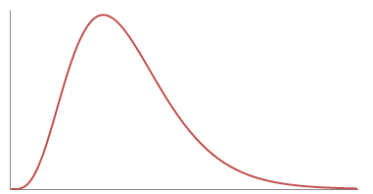


Data Generating Process
Data
Standardized Statistic
$$T^{∗}=\frac{MSR}{MSE}$$
Model for
Null Distribution
Model for Response in Null World
Simulated Data
p-value
$${\left(\text{Response}\right)}_{i}=f\left(θ_{0},\text{Predictors}\right)+ε_{i}$$
$$\text{Values} \text{of} T^{∗} \text{Under} H_{0}$$
Classical Modeling Conditions on Error

